Slide 1



DEPARTMENT OF ARTIFICIAL INTELLIGENCE & DATA SCIENCE
SECOND REVIEW
TEAM MEMBERS:
KAVIN K V (927621BAD021)
DINESH S (927621BAD011)
SHARAN ADHITHYA S (927621BAD047)
GUIDED BY:
Mrs. P. VIDHYA

Slide 2
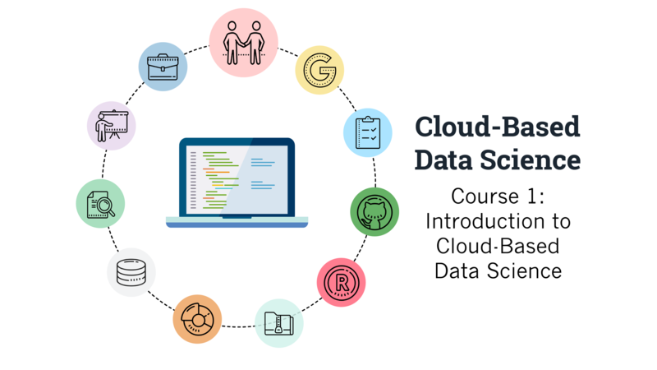
A Comprehensive Guide to Global Tourism and Cultural navigation

Slide 3
ABSTRACT
An intelligent tourist guide employs advanced technologies such as artificial intelligence and data analytics to enhance the travel experience.
Utilizing location-based services, user preferences, and historical data, the system delivers personalized recommendations for attractions, dining, and activities.
Real-time updates, interactive maps, and multi-modal transportation information contribute to a seamless and tailored journey, providing travelers with an intelligent and efficient guide to explore destinations.

Slide 4
OBJECTIVES
A tourism guide system project aims to provide comprehensive information and assistance to travelers visiting a particular destination.
For Accessing information and services, ensuring that travelers can navigate the system effortlessly.
Offer detailed information about tourist attractions, historical sites, accommodations, restaurants, transportation options, local events.
Provide content and support in multiple languages to cater to the diverse needs of travelers from different regions.

Slide 5
PROBLEM STATEMENT
Now a days tourism is booming globally and online tourist guide is one of the important factors which promote and assist tourism in many ways so intelligent tourist guide is one of the main needs in the modern day tourism.

Slide 6
LITERATURE SURVEY
1 | A Systematic Literature Review of Tour Guide Performance | Marceilla Suryana | To be related to tourist satisfaction, tourist experience, behavior in the destination and the desire to revisit
2 | Tour Guide Performances, Tourist Satisfaction And Behavioural Intentions | Syakier, W. A., & Hanafiah, M. H. | A Study On Tours In Kuala Lumpur City Centre. Journal of Quality Assurance in Hospitality and Tourism
3 | Tour guides’ performance and tourists’ immersion | Hansen, A. H., & Mossberg, L | facilitating consumer immersion by performing a guide plus role. Scandinavian Journal of Hospitality and Tourism
4 | Virtual Tourist Guide | Shila Jawale , Sakshi Jadhav, Priyanka Jaybhaye , Nikita Sonavale | Virtual Tour, Android Based Guide Application, Gmap
5 | Virtual Reality Based Virtual Tour of College Using Unity 3D | Chaisoong, U., & Tirakoat, S | The proposed system virtual tour of college specifically on Unity3D which provides virtual view of college infrastructure

Slide 7
LITERATURE SURVEY
6 | Design and Implementation of Threedimensional Virtual Tour Guide Training System Based on Unity3D | Burta, A., Szabo, R., & Gontean | provides a training environment with strong interactivity and immersion for the trainers, enabling them to "go to" the scenic spot
7 | TOURIST GUIDE APPLICATION (CHAR DHAM YATRA & OTHER PLACES) IN UTTARAKHAND STATE | Yogendra Singh Chawda | To provide a search platform where a tourist can find their tour places according to their choices.
8 | An innovative mobile electronic tourist guide application1 | M. Kenteris, D. Gavalas and D. Economou | To promote responsible and interesting tourism so that people can enjoy their holidays at their favourable places
9 | A multiplatform mobile application tourist guide exemplar | M. Kenteris, D. Gavalas and D. Economou | To develop tourism with different cultures so that they enrich the tourism experience and build pride.
10 | Go.Travel – A Smart Tourism Guide Mobile Application | Wong Yit Meng, Abdul Samad Bin Shibghatullah, Kasthuri Subaramaniam | This enables visitors to Malaysia to take advantage of tourism-related services to enhance their travels

Slide 8
PROPOSED SYSTEM
Users can create accounts or log in using social media credentials.
Users can search for destinations, attractions, accommodations, and activities based on various criteria such as location, category, ratings, and reviews.
Personalized itinerary planning based on user preferences, interests, budget, and available time.
Users can provide feedback, report issues, or seek assistance through the website.

Slide 9
DATA COLLECTION
Publicly Available Data
Government Tourism Websites
OpenStreetMap (OSM)
Travel Associations & Industry Reports
Web Scraping
Blogs
Review sites
Local business website
Surveys & User-Generated Content
Tourist Surveys
Social Media Analysis
Reviews & Ratings

Slide 10
METHODOLOGY
User Interface
Tour Package
Recommendation System
Help & issues in payment
Review and Rating

Slide 11
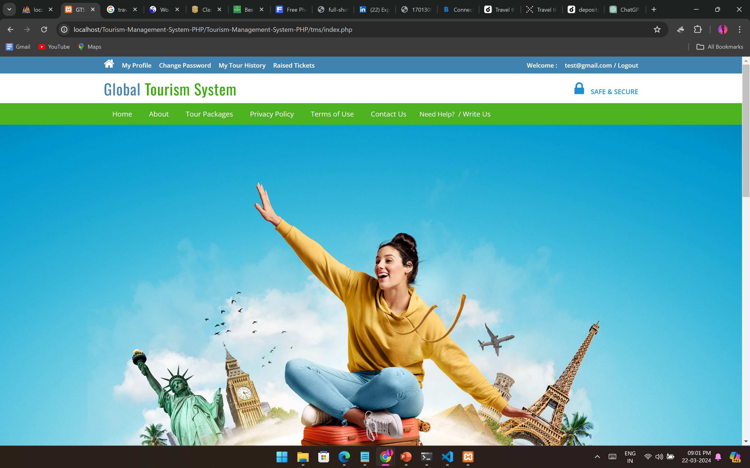
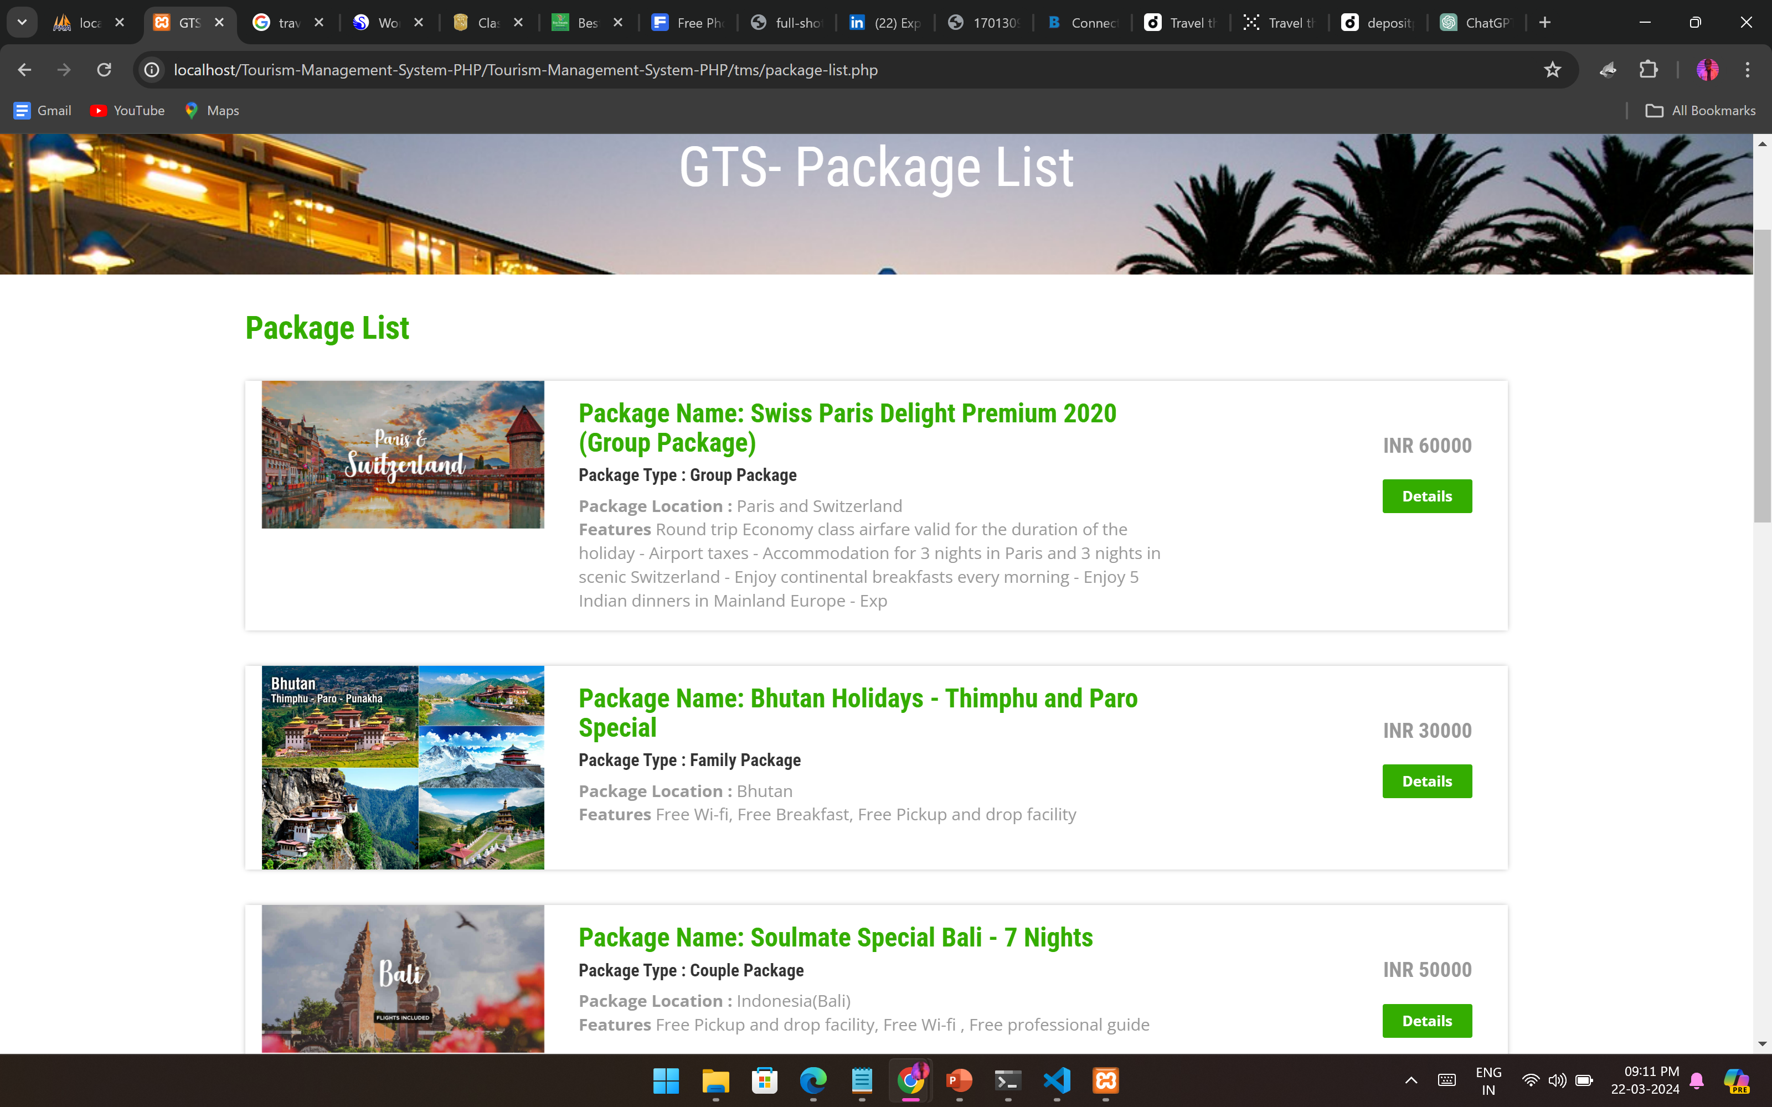
IMPLEMENTATION

Slide 12
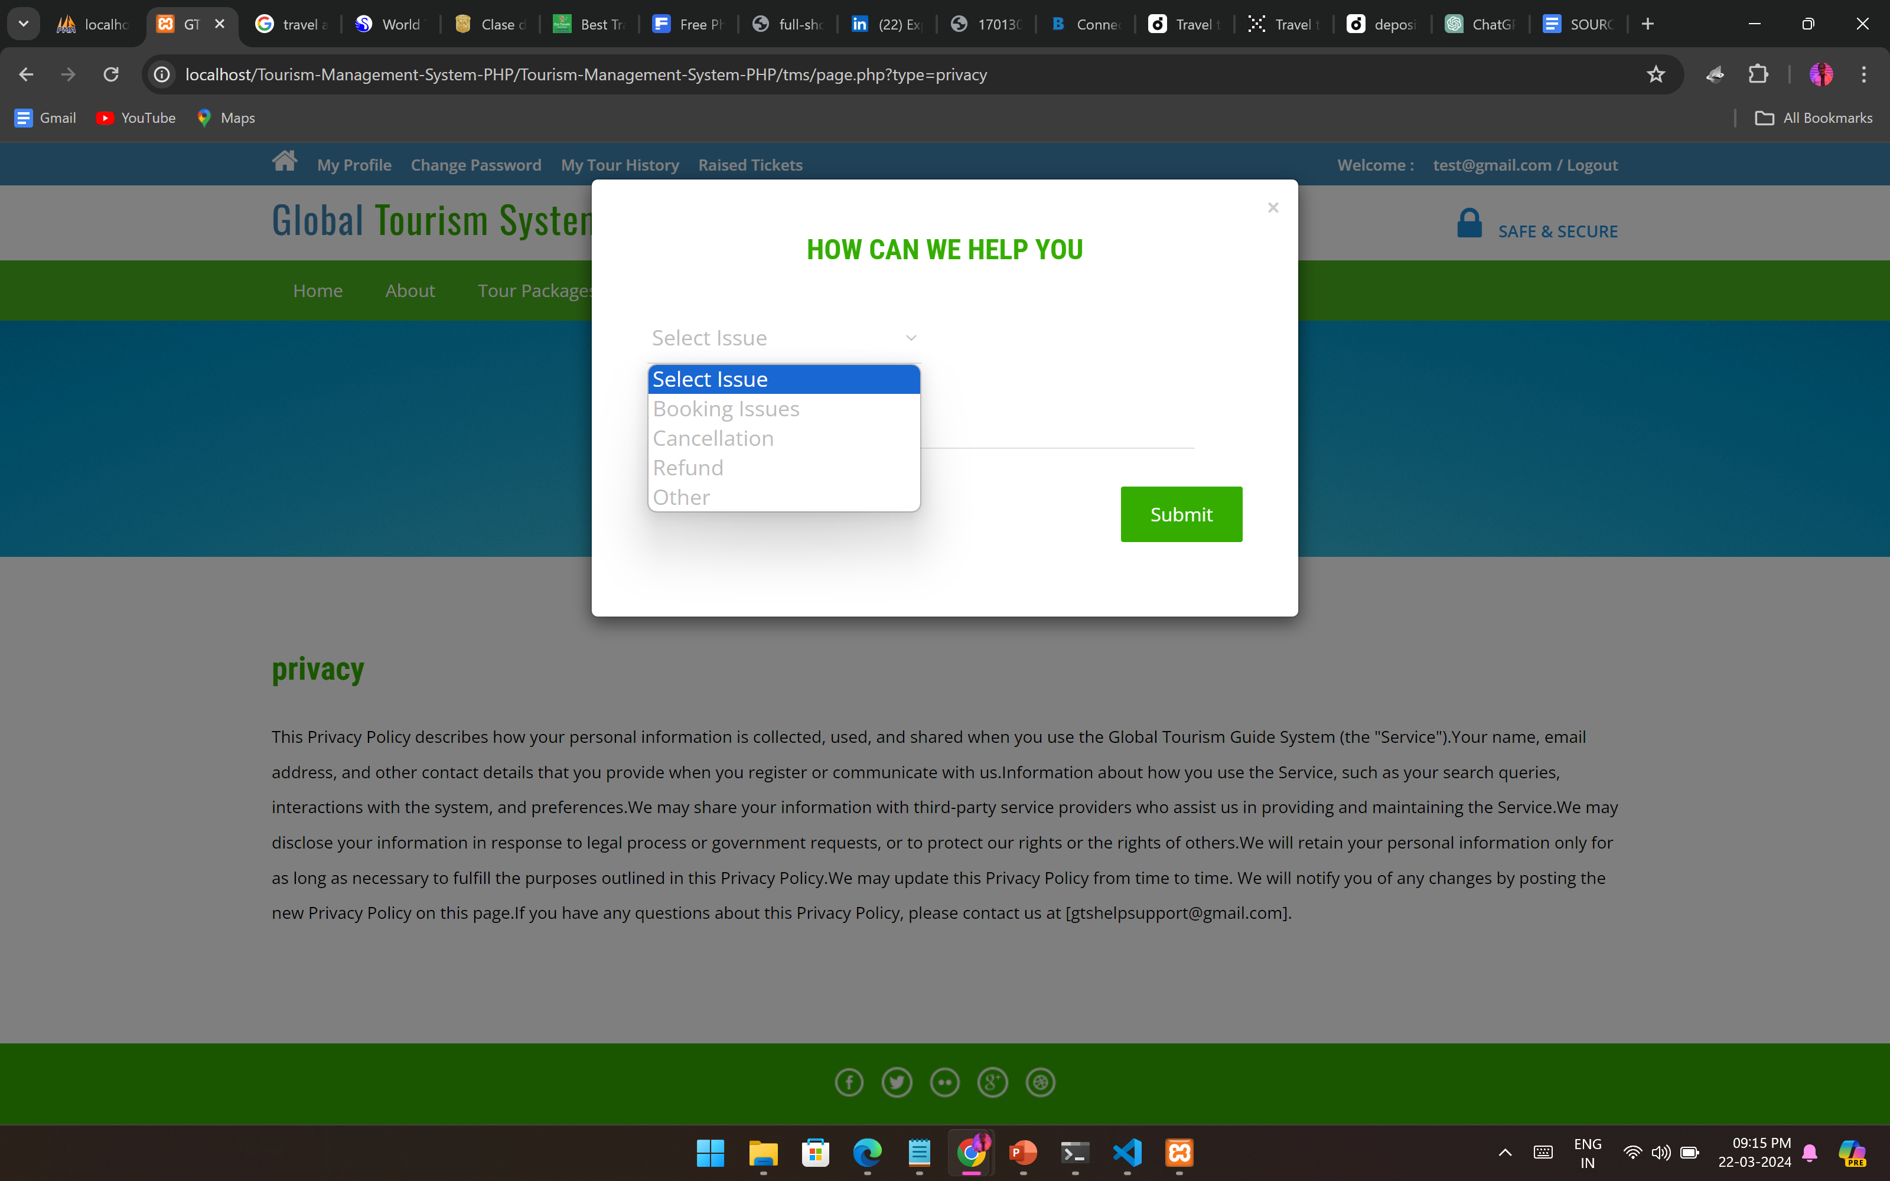
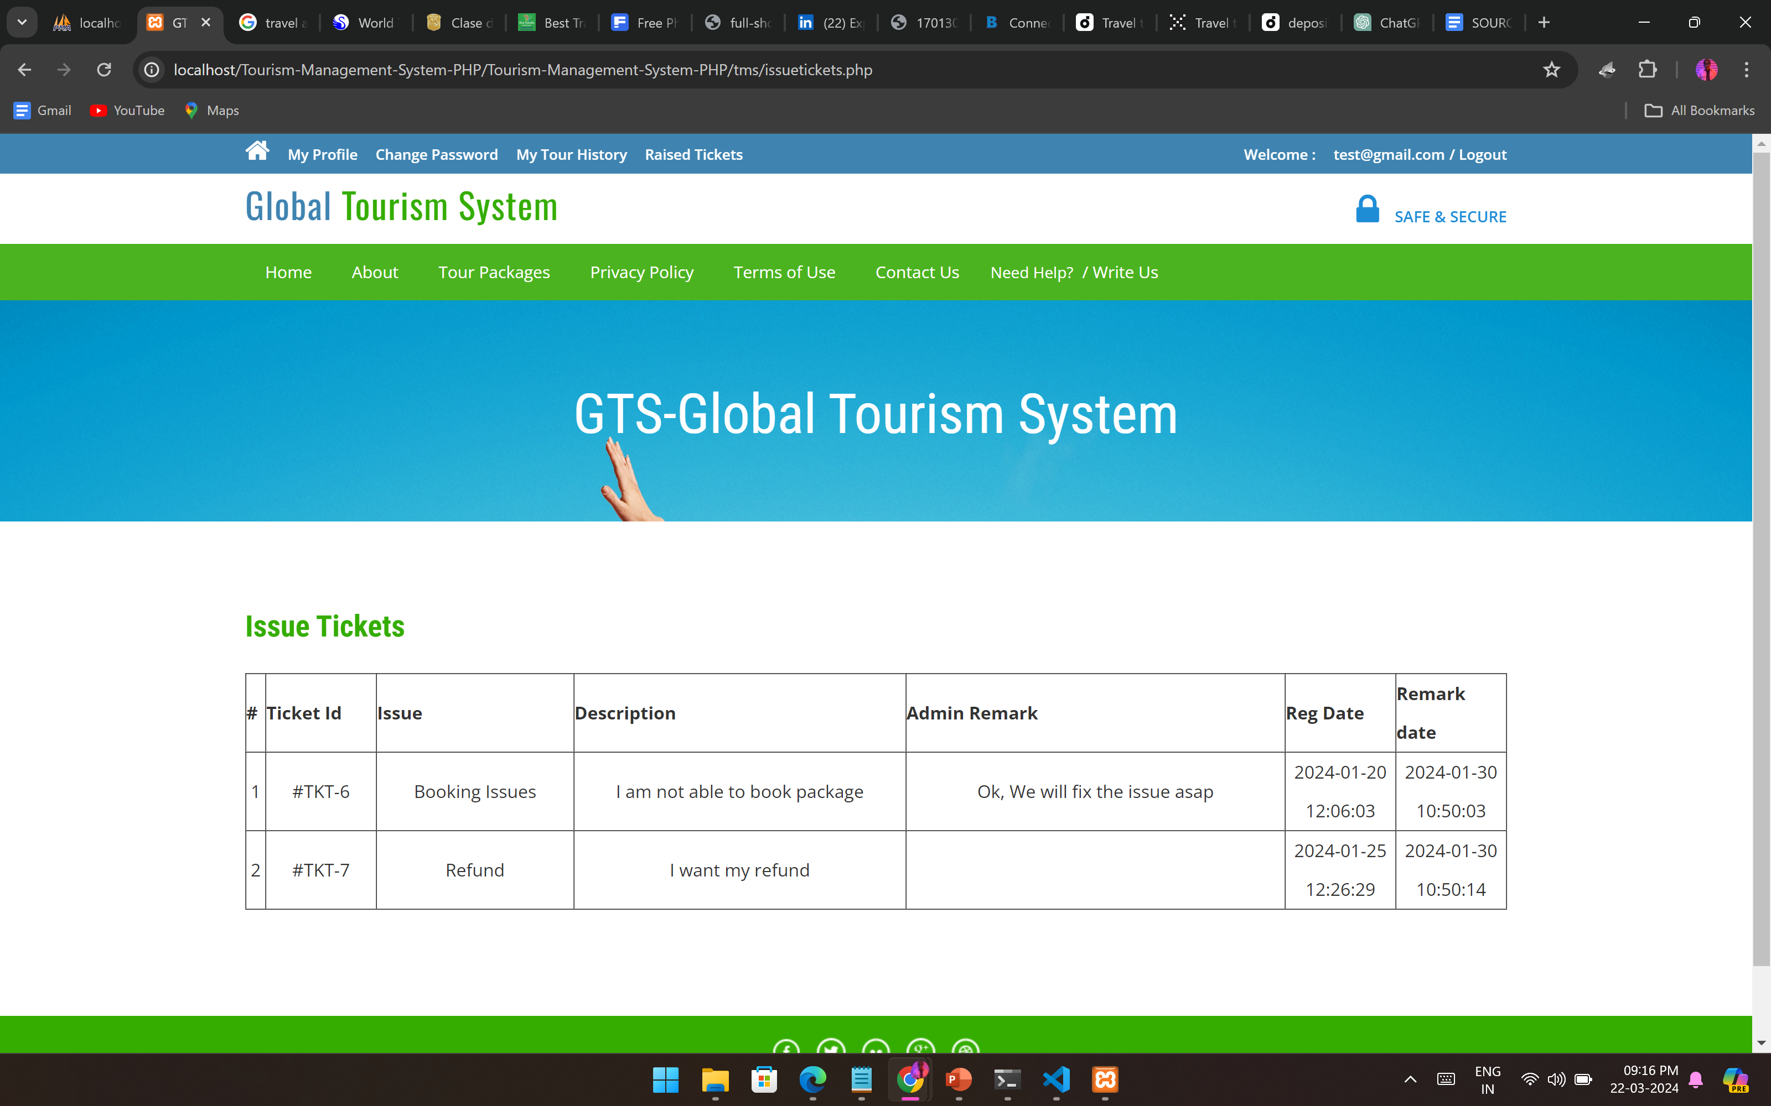
IMPLEMENTATION

Slide 13
RESULTS & FUTURE STEPS
The implementation of an intelligent tourist guide represents a significant advancement in the travel industry.
Leveraging technologies like artificial intelligence and machine learning, it offers personalized recommendations, real-time information, and seamless navigation, enhancing the overall tourist experience.

Slide 14
REFERENCES
[1] International Journal for Innovative Research in Science & Technology Tourist guide for Tamil Nadu by P.K. Jithin, M. Vishnuram, P. Prasath, J.T. Thirukrishna, 2018.
[2] . Smart travel guide by Dadape Jinendra R, Jadhav Bhagyashri R, Gaidhani Pranav V, Vyavahare Seema U, AchaliyaParag N, 2012.
[3] Iguide – Intelligent tour guiding system by T.G.I. Bingun a, C.M. Palliyaguru b, V.M.P. Godakandage c, K.K.A.W. Madhubhashana d, S.A.U.S. Samaratunge e, T.D. Perera, 2017.
[4] Intelligent Tourist Information System by Krzysztof Jele?, 2008.
[5] Android Based Tourist Guide System by Prof. S.S. Pawar, Pooja Chavhan, Arti Lohar, Ashwini Kadam and Priyanka Ranjane, 2016.

Slide 15
THANK YOU !

